Slide 1
The Big Data Revolution

Slide 2
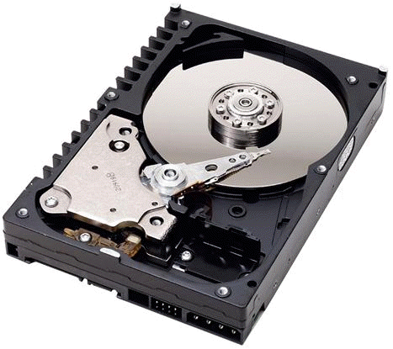
Hard Drives

Slide 3

Cloud

Slide 4
WHAT IF WE COULD RECORD EVERYTHING?

Slide 5
WHAT IF WE COULD TRY EVERYTHING?

Slide 6
Quantum computing is dead
@LlewellynFalco

Slide 7
Quantum computing is alive
@LlewellynFalco

Slide 8
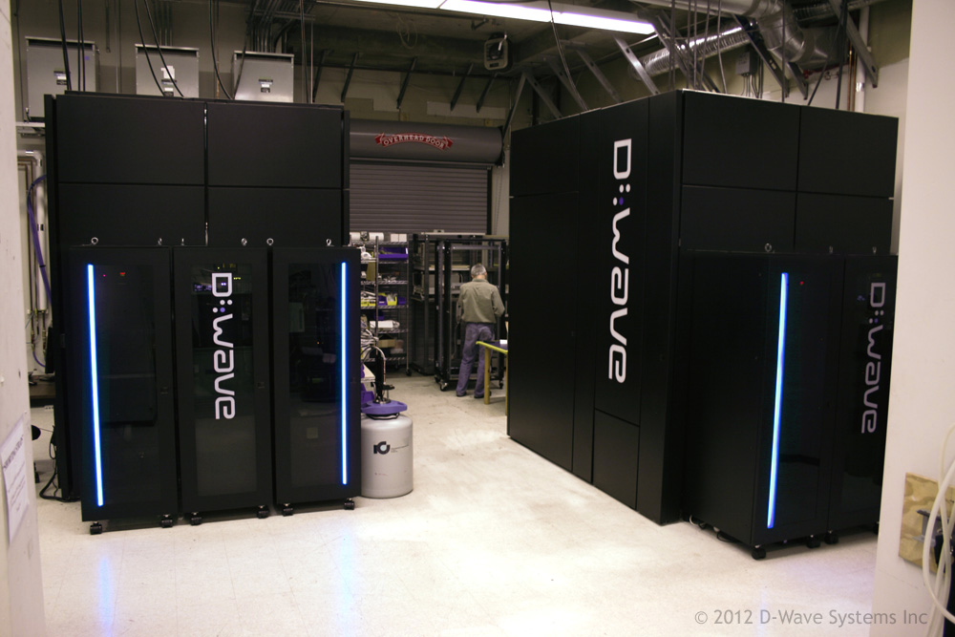

Slide 9
Brute Force Combinatorics

Slide 10
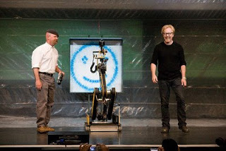
CPU

Slide 11
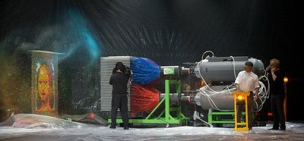
GPU

Slide 12
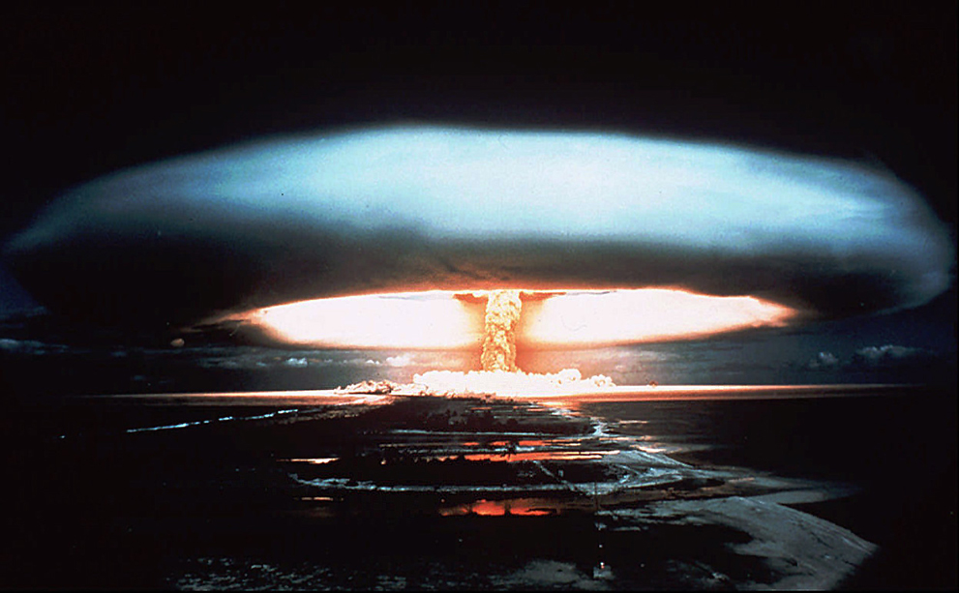
Quantum
3,000,000,000,000
,000,000,000,000
,000,000,000,000
,000,000,000,000

Slide 13
Prime Factors

Slide 14
What are the prime factors of 43143988327398957279342419750374600193 ?

Slide 15
Does 32753465664812 * 1432432534762432 = 43143988327398957279342419750374600193 ?

Slide 16
1st
2nd

Slide 17
Probability Calculate(Bit[] scenario)

Slide 18
Probability Calculate(Bit[] scenario)
{
var myScenario = Transform(scenario);
Return CalculateFor(myScenario);
}

Slide 19
6 QuBIT Example

Slide 20
What are the prime factors of 35?

Slide 21
1st
2st
000
001
010
011
000
001
010
011
100
101
5
110
111
100
101
110
111
7

Slide 22
✗
000000
Step 1: INPUT
Step 2: Transform
Step 3: Calculate
0
X
0
Step 4: CORRECTNESS
0
=
35
?

Slide 23
✗
000001
Step 1: INPUT
Step 2: Transform
Step 3: Calculate
0
X
1
Step 4: CORRECTNESS
0
=
35
?

Slide 24
✗
000010
Step 1: INPUT
Step 2: Transform
Step 3: Calculate
0
X
2
Step 4: CORRECTNESS
0
=
35
?

Slide 26
000000
000001
000010
000011
000100
000101
000110
000111
001000
001001
001010
001011
001100
001101
001110
001111
010000
010001
010010
010011
010100
010101
010110
010111
011000
011001
011010
011011
011100
011101
011110
011111
100000
100001
100010
100011
100100
100101
100110
100111
101000
101001
101010
101011
101100
101101
101110
101111
110000
110001
110010
110011
110100
110101
110110
100111
111000
111001
111010
111011
111100
111101
111110
111111

Slide 27
000000
000001
000010
000011
000100
000101
000110
000111
001000
001001
001010
001011
001100
001101
001110
001111
010000
010001
010010
010011
010100
010101
010110
010111
011000
011001
011010
011011
011100
011101
011110
011111
100000
100001
100010
100011
100100
100101
100110
100111
101000
101001
101010
101011
101100
101101
101110
101111
110000
110001
110010
110011
110100
110101
110110
100111
111000
111001
111010
111011
111100
111101
111110
111111

Slide 28
128 Qubits = 2^128 = 3.4E38 = 340,282,370,000,000,000,000, 000,000,000,000,000,000

Slide 29
Platform as a service

Slide 30
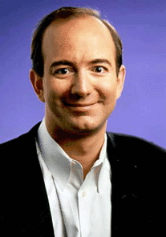
Jeff Bezos

Slide 31
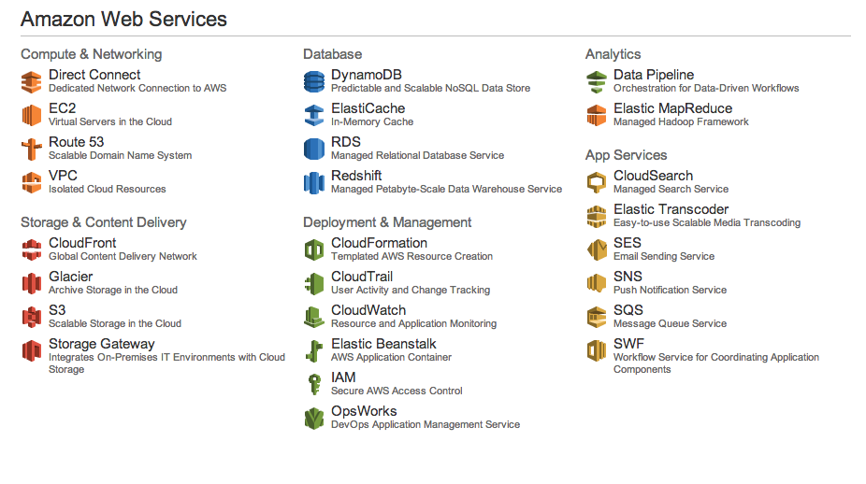

Slide 32
WHAT IF you COULD TRY EVERYTHING?

